Slide 1
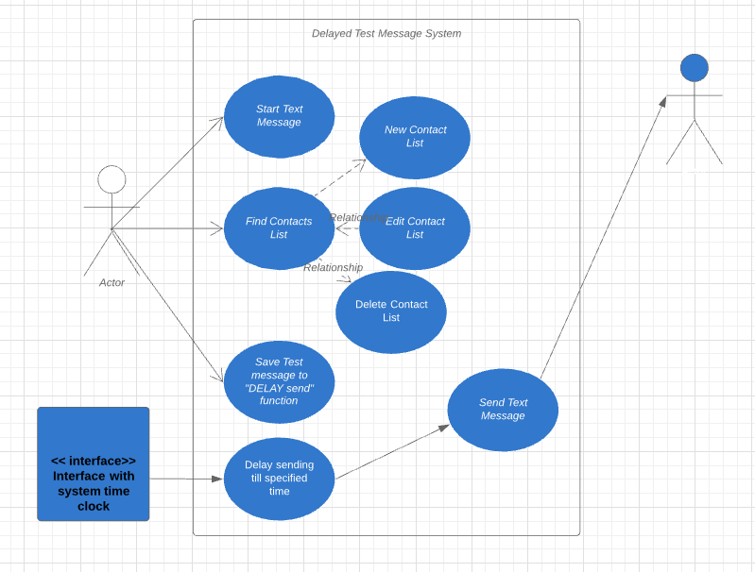
Use Case Diagrams
The primary purpose of use case diagrams is to identify functions and how roles interact with them.
They visually show how roles interact with the system and the functionality provided by the system.
They identify internal and external factors.
Notes:
Use Case Diagrams is a graphical representation of what a system must DO.
Dynamic or Behavioral UML Diagram – meaning what must happen in a model. (not what is contained)
A set of actions, services, and functions that they system needs to perform

Slide 2
Use Case Diagrams
Consist of 4 objects: Actor, Use Case, System and Package.
The Actor can be the entity that performs the role.
A use case represents a function or an action within the system.
The system is used to define the scope of the use case.
The package usually group use cases together.
Notes:
Actor: for an Android Application it can be the person interacting with the application. DRAWN like a skeleton and placed on the outside of the system. They are the “USERS”
Use Case – When thinking of Use Cases – think of the end goal of a user. DRAWN as an oval and named with a function
The system - is an optional element. Usually used when visualizing large systems like a business network. In this example, the system defines the parameters of an Android text messaging application. DRAWN as a rectangle.
The package - is used for more complex diagrams, perhaps showing the network system on a college campus with multiple buildings with multiple floors. DRAWN kinda like a file folder with it’s package name on top.
The arrows are used to show the correlation between objects. We have one way arrows and 2-way arrows in this diagram. Relationships defined as:
Uses – needed by another in order to perform a task.
Expends – alternative options between functions.

